Slide 1

Customer Reviews Analysis
02-06-2024

Slide 2
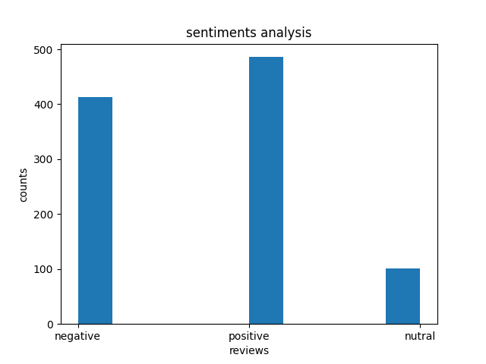
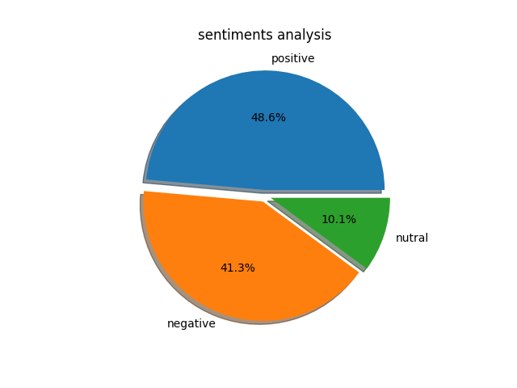
Reviews Analysis
Histogram Analysis of Number of Reviews
Pie Chart is Showing Percentage of Reviews

Slide 3
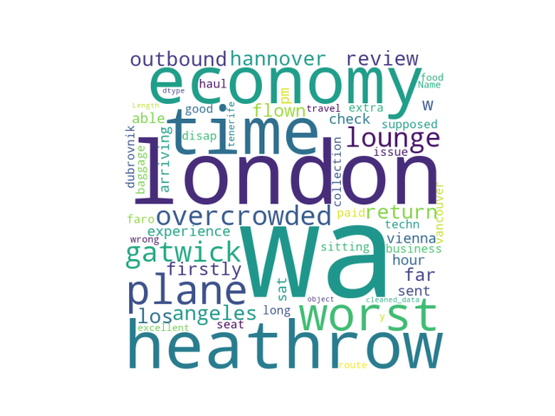
Sentiments Analysis
These are the most frequently used words in our 1000 reviews dataset. London and Heathrow are the most visited places. Most of the words are showing negative sentiments.

